Slide 1



Real-Time Traffic Analytics (Graduation project(

Slide 2
Our Team
- Abdelhakim Abdelaziz:
- Ahmed Mostafa
- Sarah Mohamed
- Shahd Mohamed
- Wessal Osama

Slide 3
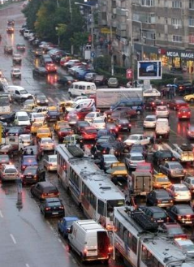
Problem Statement

Slide 4
Modern cities suffer from severe traffic congestion, delays, and inconsistent traffic flow.
Why it happens:
No real-time monitoring system for roads.
Traditional traffic systems provide outdated or slow information.
Delayed detection of accidents, road closures, and congestion.
Limited integration between traffic data sources.
Impact on society:
Longer travel time and wasted fuel.
Higher rate of accidents and emergency delays.
Reduced productivity and city efficiency.
Increased stress and poor commuter experience.

Slide 5
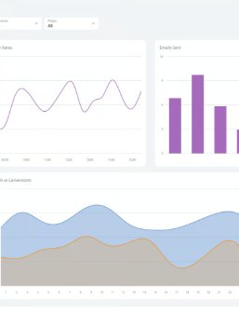
Proposed Solution
.

Slide 6
Our Solution: A real-time traffic analytics system built on Microsoft Azure that monitors live traffic conditions, detects congestion, and sends instant alerts.
How it works:
Collects live traffic & weather data from external APIs.
Streams the data into Azure Event Hub continuously.
Processes it in real-time using Azure Stream Analytics.
Detects congestion, anomalies, road incidents, and speed drops.
Stores processed data in Azure SQL for reporting.
Displays everything instantly on a Power BI live dashboard.
Why this solution:
Fast, scalable, cloud-based, and highly reliable.
Provides real-time insights instead of delayed reports.
Helps users and authorities make quicker decisions.

Slide 7
SDGs (Goals Supported)
.

Slide 8
Real-Time Traffic Analytics supports:
SDG 9 – Industry, Innovation & Infrastructure Smart traffic systems using real-time data
SDG 11 – Sustainable Cities & Communities Safer roads, less congestion, better mobility
SDG 13 – Climate Action Lower emissions by reducing traffic congestion
.

Slide 9
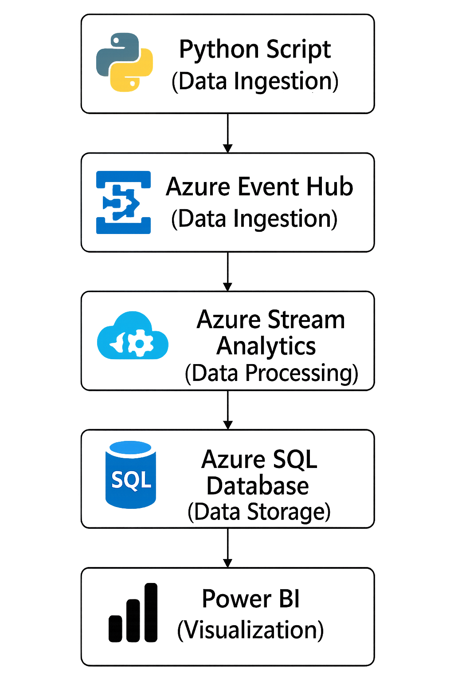
System Architecture
Real-time data is collected from external traffic and weather services.
Python handles data ingestion and sends streaming events to Azure Event Hub.
Azure Stream Analytics processes and transforms the incoming data in real time.
Cleaned and structured data is stored in Azure SQL Database.
Power BI connects to the database to visualize insights and monitor performance.

Slide 10
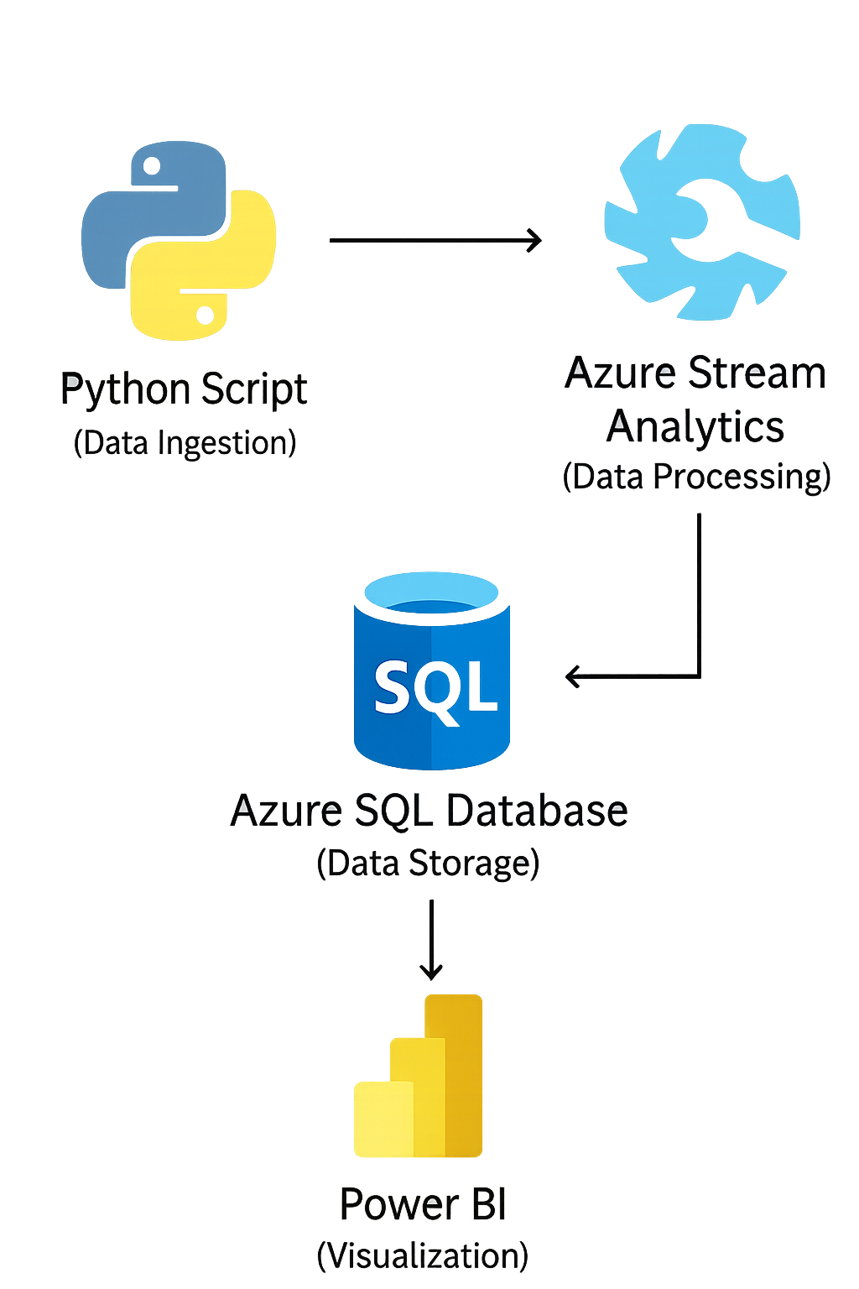
Data Flow (DFD Level 0 / Level 1)
Level 0:
Real-time data flows
from APIs → Python → Azure Stream Analytics → Azure SQL Database → Power BI Dashboard.
Level 1:
Azure Stream Analytics filters, aggregates, and analyzes traffic data to detect congestion and incidents before storing it in Azure SQL Database.

Slide 11

APIs Used
.

Slide 12

External APIs TomTom APIs: Geocoding, Traffic Flow, and Live Traffic Incidents OpenWeather API: Real-time Weather Data (Temperature, Humidity, Wind)
.
.

Slide 13

Technologies Used

Slide 14
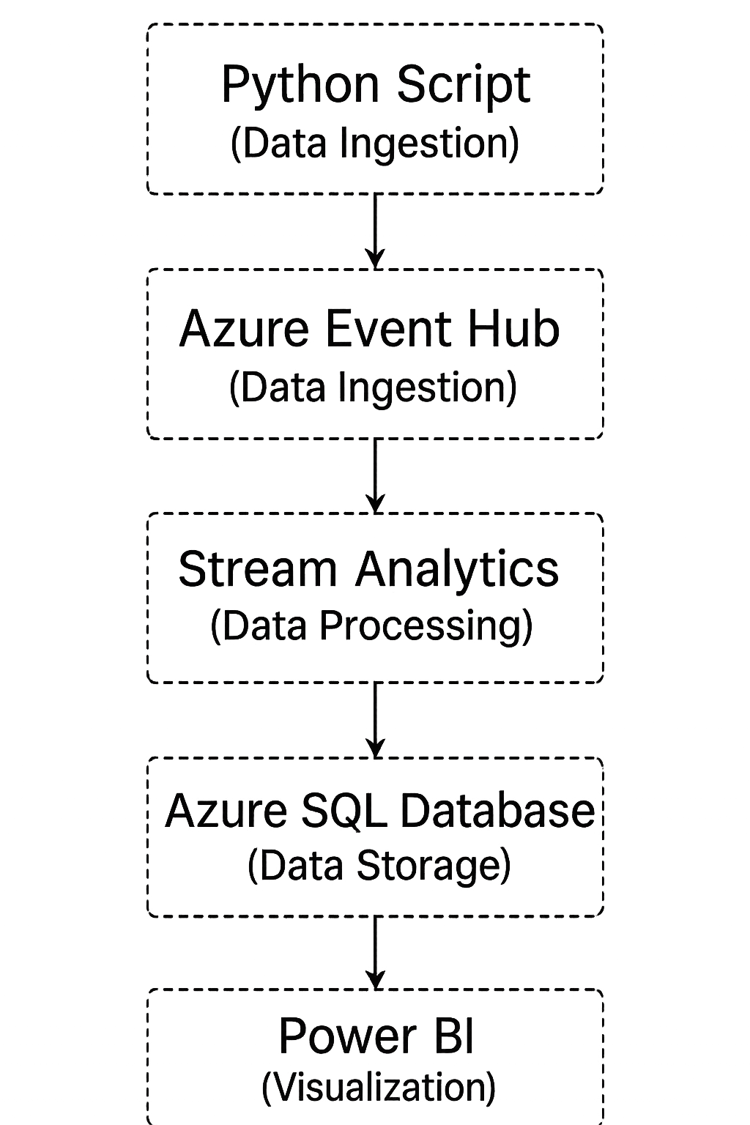
- Python: For API integration and data processing - Azure Event Hub: For real-time data ingestion - Azure Stream Analytics: For real-time data analysis - Azure SQL Database: For data storage - Power BI: For dashboard visualization and alerts

Slide 15
Stream Analytics Logic
Calculate average traffic speed in real-time
Detect congestion patterns
- Generate alerts for incidents and anomalies

Slide 16
Database Design
- Main Tables:
• Region: Stores area information
• TrafficRecord: Stores traffic data (speed, congestion, timestamp)
• Alert: Stores system-generated alerts
- Relationships:
• Each Region → multiple TrafficRecords
• Each TrafficRecord → multiple Alerts
.

Slide 17
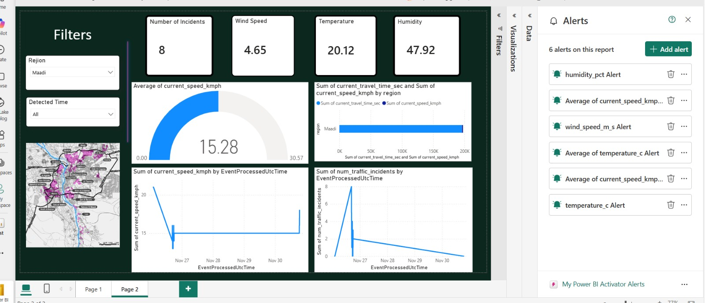
Dashboard
Real-time traffic and weather monitoring
Interactive and dynamic visualizations
City-based traffic & weather analysis
Live congestion and incident detection
Performance KPIs and trend analysis

Slide 18
Results
- Latency: < 10 seconds
- Accuracy: > 95%
- Real-time refresh every 5 seconds
- Congestion detected in real-time

Slide 19
Challenges
- API rate limits
- Stream Analytics job errors
- Handling missing or incomplete data
- Dashboard performance with large datasets
.

Slide 20

Future Improvements
- Add ML-based anomaly detection
- Enrich data (weather, lane info)
- Traffic forecasting
- Improve security and optimize Azure costs

Slide 21
Conclusion
- Solves a real-world traffic problem
- Real-time monitoring and alerting
- Scalable architecture on Azure
- Ready for wider deployment
.

Slide 22
thank you
.

